Slide 1
ML4A Project: ASHRAE Dataset
Students
Taras Kutsyk
Anastasiia Bondarenko
Supervisor
Prof. Alessandro D'Innocenzo

Slide 2
Table of contents
Introduction to the ASHRAE dataset
Problem formulation
Dataset preprocessing
Lag matrix
Models we used
Models validation results
Results discussion

Slide 3

ASHRAE dataset: introduction
ASHRAE is an American association that focuses on building systems & energy efficiency. In 2019, it provided a dataset to be used in a Kaggle competition for building ML models to predict metered building energy usage in the following areas: chilled water, electric, hot water, and steam meters.
The data comes from over 1,000 buildings over a three-year timeframe (we used only the year 2016).

Slide 4
ASHRAE dataset: structure
train.csv
building_id - Foreign key for the building metadata
timestamp - When the measurement was taken
meter - The meter id code. Read as {0: electricity, 1: chilledwater, 2: steam, 3: hotwater}
meter_reading - The target variable. Energy consumption in kWh (or equivalent).
building_meta.csv
building_id - Foreign key for training.csv
site_id - Foreign key for the weather files.
primary_use - Indicator of the primary category of activities for the building based on EnergyStar property type definitions
square_feet - Gross floor area of the building
year_built - Year building was opened
floor_count - Number of floors of the building
weather_train.csv
site_id - Foreign key for the weather files.
timestamp - When the measurement was taken
air_temperature - Degrees Celsius
cloud_coverage - Portion of the sky covered in clouds, in oktas
dew_temperature - Degrees Celsius
precip_depth_1_hr - Millimeters
sea_level_pressure - Millibar/hectopascals
wind_direction - Compass direction (0-360)
wind_speed - Meters per second

Slide 5
Problem formulation
Task #1:
Predict an outside temperature after N hours (N = 1, 2, …, 24), given the lags of energy usage, outside temperature and other weather data (forecast).
Task #2:
Predict an energy consumption given the lags of weather data, building metadata and, optionally, the lags of energy consumption.

Slide 6
Dataset preprocessing
We preprocessed the dataset to resolve its 2 main challenges:
Number of missing records
The dataset length
In the initial format, the dataset contained over 20 million records, which was infeasible for the most models to handle, given the computational recourses we had available (and considering that we had to fit each model 24 times for Task #1).

Slide 7
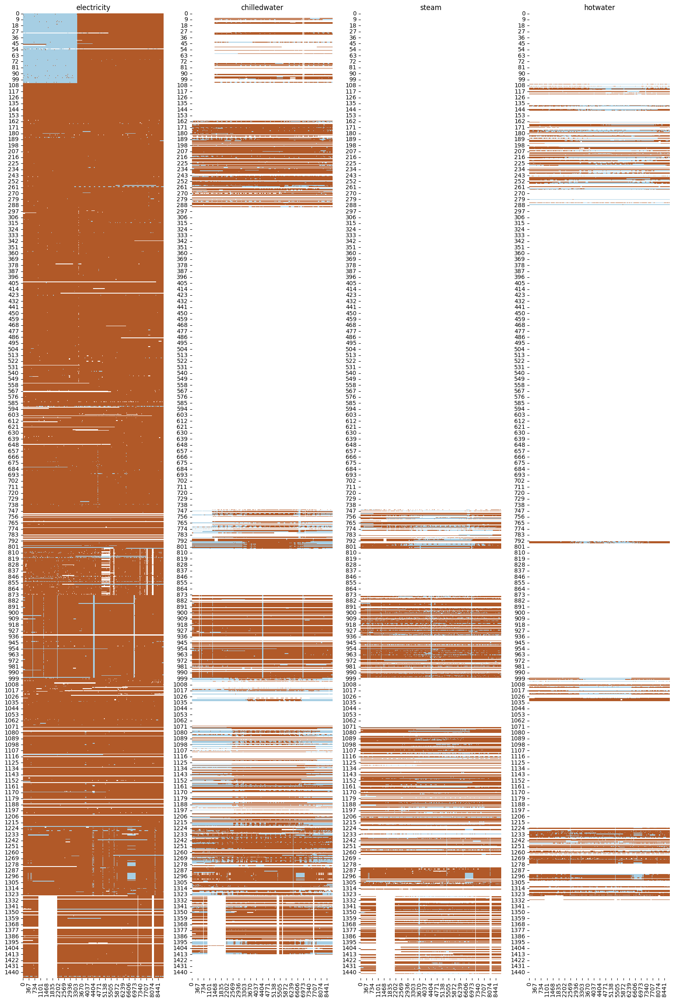
Missing records
On the right you can see a heatmap of time vs. presence of measurements for each building.
Legend:
X axis: hours elapsed since the beginning of the dataset
Y axis: building_id
Brown: meter reading available with non-zero value
Light blue: meter reading available with zero value
White: missing meter reading

Slide 8
Main preprocessing steps
Include records only for the electricity meter (which contains the most data).
Resample the dataset to 1-hour frequency:
Some buildings contained too little data to apply resampling, so we discard them first.
Resample the records for the remaining buildings using linear interpolation.
Select a random subsample of the remaining buildings.
Clean NaNs: impute the missing values with the corresponding median values.
Add some time-related features, such as hour of the day etc.
Split the dataset into the training (75%) and testing (25%) sets based on the time period: May, August and November (2016) went to the testing set, and everything else was left for the training (remaining months of 2016).

Slide 9
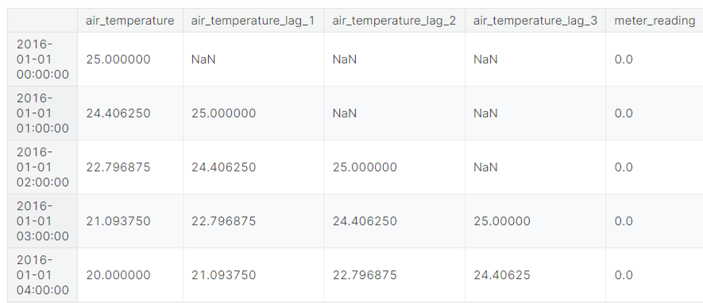
Lag matrix
…
We also added what we called “future lags” for Task #1: that is, the weather “forecast” data that we used to predict the outside temperature N hours into the future.

Slide 10
Models
We had to reduce our dataset to test the Kernel and SVM models
Dataset Size:
training: 276191 samples
testing: 92735 samples
Models:
Linear Models
Linear Regressor
Ridge
Lasso
Passive Aggressive Regressor
SGD Regressor
Decision Tree Regressor
Random Forest Regressor
Dataset Size:
training: 6568 samples
testing: 2200 samples
Models:
Linear Models
Linear Regressor
Ridge
Lasso
Passive Aggressive Regressor
SGD Regressor
Kernel Ridge
SV Regressor
Decision Tree Regressor
Random Forest Regressor

Slide 11
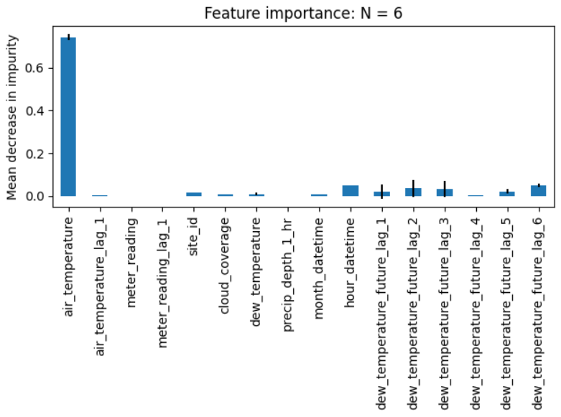
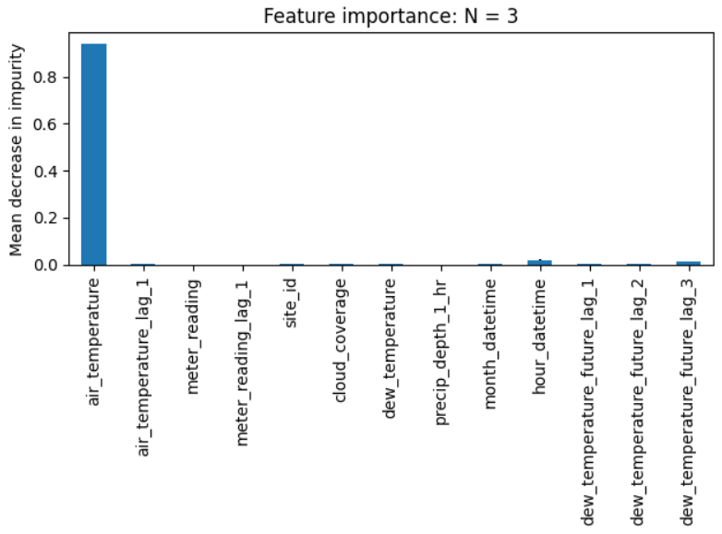
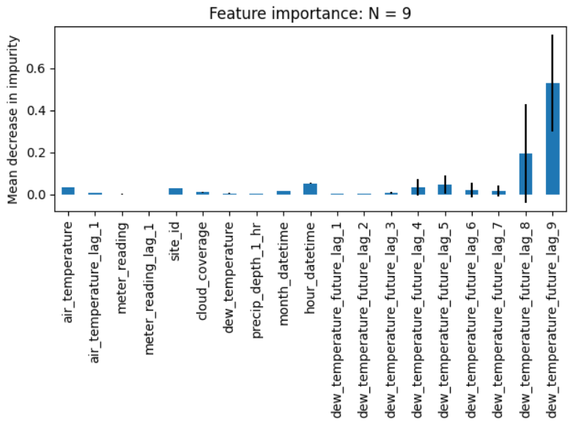
Task #1(big dataset): Feature importance
Goal:
Predict an outside temperature after N hours (N = 1, 2, …, 24), given the lags of energy usage, outside temperature and other weather data (“future lags” - here we chose only the dew temperature).

Slide 12
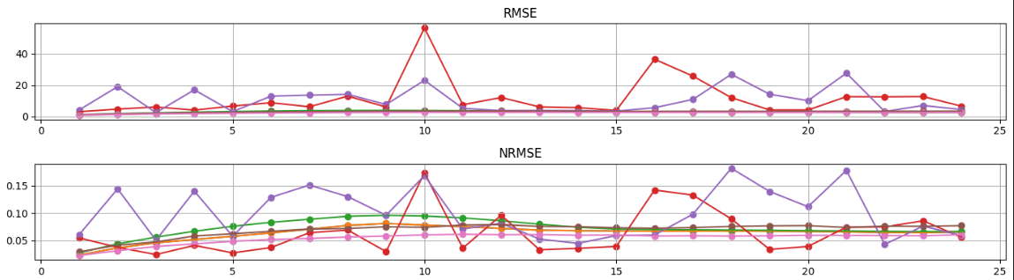
NRMSE
RMSE
Model / Lags | 2 | 4 | 6 | 8
Linear Regression | 3.15 | 3.031 | 2.903 | 2.772
Ridge | 3.15 | 3.031 | 2.903 | 2.772
Lasso | 3.317 | 3.187 | 3.099 | 2.979
Passive Aggressive Regression | 11.462 | 10.471 | 9.733 | 11.596
SGD Regression | 5.35 | 6.876 | 8.034 | 10.333
Decision Tree | 3.171 | 3.137 | 3.123 | 3.091
Random Forest | 2.474 | 2.446 | 2.416 | 2.38
Model / Lags | 2 | 4 | 6 | 8
Linear Regression | 0.072 | 0.068 | 0.065 | 0.064
Ridge | 0.072 | 0.068 | 0.065 | 0.064
Lasso | 0.08 | 0.077 | 0.075 | 0.073
Passive Aggressive Regression | 0.084 | 0.067 | 0.061 | 0.064
SGD Regression | 0.087 | 0.091 | 0.092 | 0.099
Decision Tree | 0.071 | 0.07 | 0.069 | 0.069
Random Forest | 0.057 | 0.056 | 0.055 | 0.054
Lags = 8

Slide 13
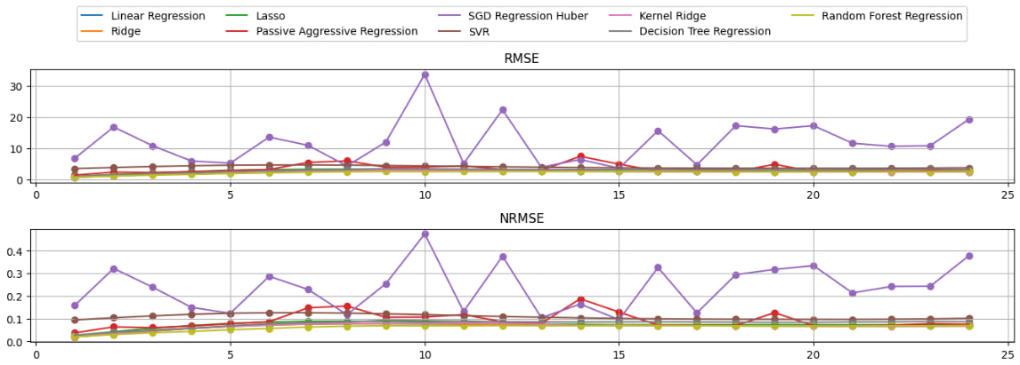
Task #1(small dataset): Validation
Model | Mean RMSE | Mean NRMSE
Linear Regression | 2.428 | 0.066
Decision Tree | 2.875 | 0.078
Random Forest | 2.25 | 0.061
SVR | 3.97 | 0.108
Kernel Ridge | 2.467 | 0.067
Lags = 8

Slide 14
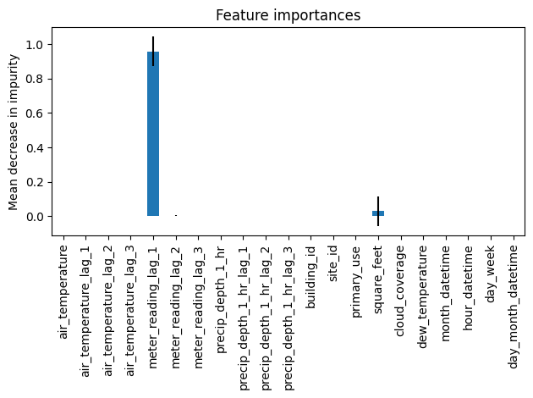
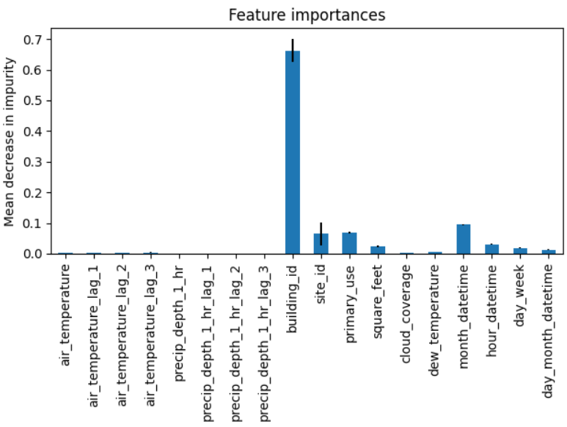
Task #2: Feature importance
Goal:
Predict an energy consumption given the lags of weather data, building metadata and, optionally, the lags of energy consumption.
With the energy consumption lag
Without the energy consumption lag

Slide 15
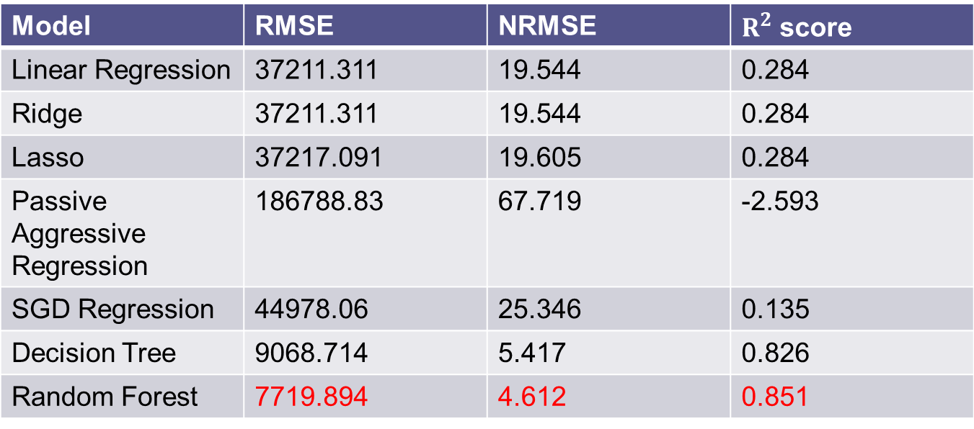
Task #2: Validation (without the energy consumption lag)
Model | RMSE | NRMSE | $R^{2}$ score
Linear Regression | 37211.311 | 19.544 | 0.284
Ridge | 37211.311 | 19.544 | 0.284
Lasso | 37217.091 | 19.605 | 0.284
Passive Aggressive Regression | 186788.83 | 67.719 | -2.593
SGD Regression | 44978.06 | 25.346 | 0.135
Decision Tree | 9068.714 | 5.417 | 0.826
Random Forest | 7719.894 | 4.612 | 0.851
Lags = 3

Slide 16
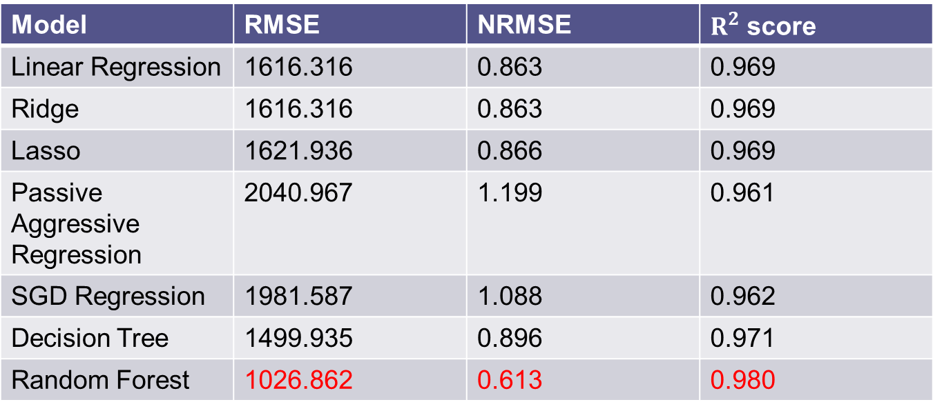
Task #2: Validation (with the energy consumption lag)
Model | RMSE | NRMSE | $R^{2}$ score
Linear Regression | 1616.316 | 0.863 | 0.969
Ridge | 1616.316 | 0.863 | 0.969
Lasso | 1621.936 | 0.866 | 0.969
Passive Aggressive Regression | 2040.967 | 1.199 | 0.961
SGD Regression | 1981.587 | 1.088 | 0.962
Decision Tree | 1499.935 | 0.896 | 0.971
Random Forest | 1026.862 | 0.613 | 0.980
Lags = 3

Slide 17
Results discussion
Task #1 (predicting the temperature):
According to the feature importance plot, the most important features were the temperature lags and (for higher N) weather forecast data.
The best performance was obtained using 8 lags and Random Forest model.
The highest error w.r.t. the prediction horizon was at around 10-12 hours.
Task #2 (predicting the energy consumption):
According to the feature importance plot, the most important features were the lags of the consumption (if included in the input features), area of the building, building ID, building use category and time-related features.
If we include the consumption lag, most of the models easily solve the tasks showing high accuracy.
If we don’t include the consumption lag, then all the linear models perform poorly; acceptable performance is achieved only with Decision Tree and Random Forest models.

Slide 18
Thank you for your attention!

